Slide 1
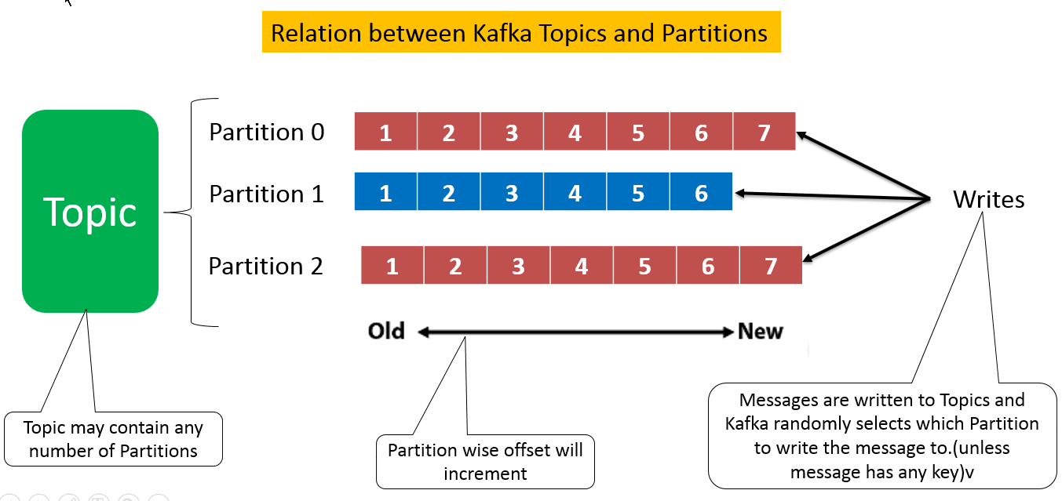
Apache Kafka Workflow | Kafka Pub-Sub Messaging
Kafka Workflow
In Kafka Workflow, Kafka is the collection of topics.
Topics are separated into one or more partitions .
partition is a sequence of messages, where index identifies each message (also we call an offset).
In a Kafka cluster, all the data is the disjoint union of partitions.
The incoming messages are present at the end of a partition, hence consumer can read them. Also, by replicating the messages to different brokers, Kafka maintains durability.
In a very fast, reliable, persisted, fault-tolerance and zero downtime manner, Kafka offers a Pub-sub and queue-based messaging system. Moreover, producers send the message to a topic and the consumer can consume the message from the topic.

Slide 2
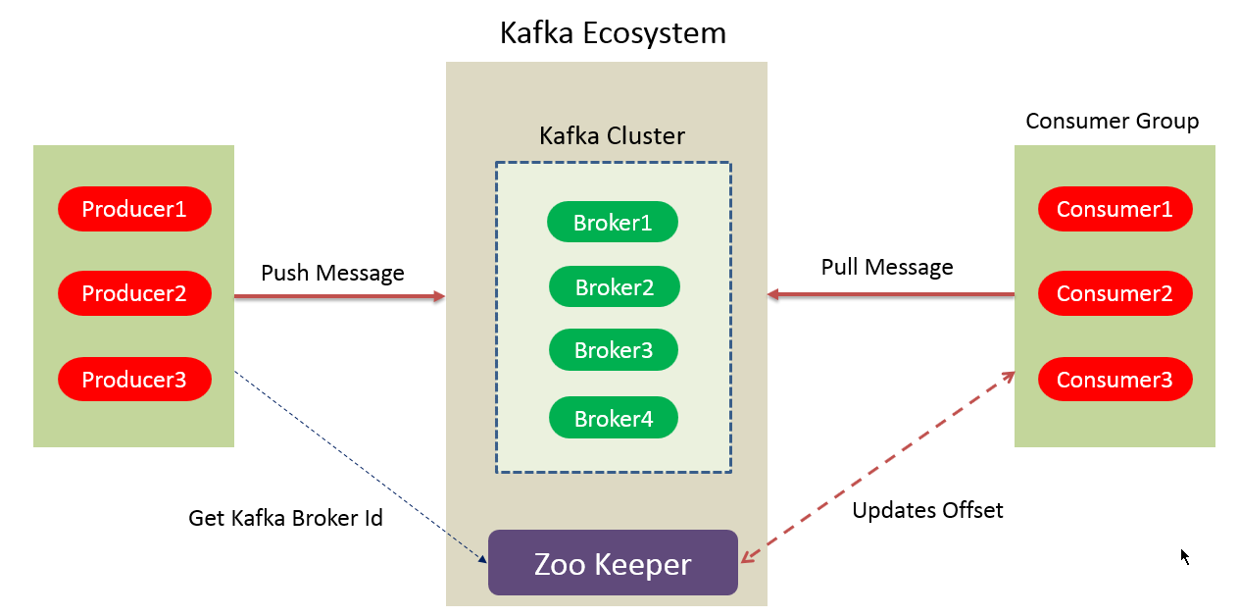
Apache Kafka Workflow | Kafka Pub-Sub Messaging
Workflow of Pub-Sub Messaging
At regular intervals, Kafka Producers send the message to a topic.
Kafka Brokers stores all messages in the partitions configured for that particular topic, ensuring equal distribution of messages between partitions. For example, Kafka will store one message in the first partition and the second message in the second partition if the producer sends two messages and there are two partitions.
Moreover, Kafka Consumer subscribes to a specific topic.
Once the consumer subscribes to a topic, Kafka offers the current offset of the topic to the consumer and save the offset in the Zookeeper ensemble.
Also, the consumer will request the Kafka in a regular interval, for new messages (like 100 Ms).
Kafka will forward the messages to the consumers as soon as received from producers.
The consumer will receive the message and process it.
Then Kafka broker receives an acknowledgment of the message processed.
Further, the offset is changed and updated to the new value as soon as Kafka receives an acknowledgment. Even during server outrages, the consumer can read the next message correctly, because ZooKeeper maintains the offsets.
However, until the consumer stops the request, the flow repeats.
As a benefit, the consumer can rewind/skip any offset of a topic at any time and also can read all the subsequent messages, as a par desire.

Slide 3
Apache Kafka Workflow | Kafka Pub-Sub Messaging
Workflow of Kafka Queue Messaging/Consumer Group
A group of Kafka consumers having the same Group ID can subscribe to a topic, instead of a single consumer, in a queue messaging system.
However, with the same Group ID all consumers, those are subscribing to a topic are considered as a single group and share the messages.
In regular intervals, Kafka Producers send the message to a Kafka topic.
Kafka stores all messages in the partitions configured for that particular topic.
Consumer in Kafka subscribes to a specific topic and consume the messages.
When we add new consumer in the Kafka system , the new consumer in Kafka will not receive any messages, if the number of Kafka consumers exceeds the number of partitions. This scenario arises because in Kafka there is a condition that each Kafka consumer will have a minimum of one partition.

Slide 4
Apache Kafka Workflow | Kafka Pub-Sub Messaging
Role of ZooKeeper in Apache Kafka
Apache Zookeeper serves as the coordination interface between the Kafka brokers and consumers. Also, we can say it is a distributed configuration and synchronization service.
Basically, ZooKeeper cluster shares the information with the Kafka servers. Moreover, Kafka stores basic metadata information in ZooKeeper, such as topics, brokers, consumer offsets (queue readers) and so on.
In addition, failure of Kafka Zookeeper/broker does not affect the Kafka cluster. It is because the critical information which is stored in the ZooKeeper is replicated across its ensembles. Then Kafka restores the state as ZooKeeper restarts, leading to zero downtime for Kafka.
However, Zookeeper also performs leader election between the Kafka brokers, in the cases of leadership failure.

